Slide 1
Progress presentation
SD Team gray
Hong chaemin
Park seojin
Cho moohyun

Slide 2
Outline
Project Directory Structure
Sampling
Sort/Partition
Shuffle
Merge
File I/O
Milestone

Slide 3
Project Directory Structure
332Project/
build.sbt
scala/distributedsorting/
master
package.scala
worker
master/
scripts/
Master.scala
generate-data.sh
MasterServiceImpl.scala
validata-solution.sh
worker/
project/
Worker.scala
src/
WorkerServiceImpl.scala
test/
MasterClient.scala
main/
ShuffleClient.scala
proto/
logic/
Distributedsorting.proto
Sampler.scala
resources/
InternalSorter.scala
application.conf
ExternalSorter.scala
RecordIterator.scala
RecordWriter.scala

Slide 4


Sampling
5. Sampling with ratio
Worker
1. Count records
6. Report sampled keys(request)
8. Report pivots(reply)
2. Report records count(request)
4. Report sampling ratio(reply)
1. Count records
5. Sampling with ratio
8
3
6
3
15
10
18
8
2. Report records count(request)
3
8
13
6
4. Report sampling ratio(reply)
12
1/3
Master
8
4
9
6
1/3
8
12
11
1
16
4
4
14
9
3. Calculate sampling ratio
$\frac{target records}{total records}= \frac{6}{6+6+6}=\frac{1}{3}$
9
6
7. Create pivots
3. Calculate sampling ratio
17
6
12
6. Report sampled keys(request)
3
4
8
9
12
17
8. Report pivots(reply)
7. Create pivots
8
1/3
12
5
17
12
17
7
2
12
6
6

Slide 5
Sort/Partition
1. Ordering
2. Partition
defghrekfjgnsoaufngieo...
asdggdkgnjhkdngimfkf…
1
2
4
6
7
8
check
Pivot(0< n <= 1 )
File #1
File #2
defghrekfjgnsoaufngieo...
asdggdkgnjhkdngimfkf…
…
2
4
6
7
8
Dictionary order
check
File #1
1
File #2
asdggdkgnjhkdngimfkf…
defghrekfjgnsoaufngieo...
Pivot(0< n <= 1 )
…
2
4
6
7
8
check
Pivot(1< n <= 2 )
4
6
7
8
check
File #1
1
File #2
2
Pivot(1< n <= 2 )
…

Slide 6
Shuffle
In the shuffle phase, each node should gather all of it’s own partition files.
Pull based shuffle – each node request one’s needed files
fileRequest
All to all communication
-> Parallelism should be concerned. (out of memory, backpressure can be problem)

Slide 7
Shuffle strategy abstraction
Shuffle Strategy: How many filerequests concurrently?
trait ShuffleStrategy
class SequentialShuffleStrategy
class LimitedConcurrencyShuffleStrategy
???
One file at a time
For correctness testing
Wave based / batch based
For performance optimization
or Thundering Herd Problem

Slide 8
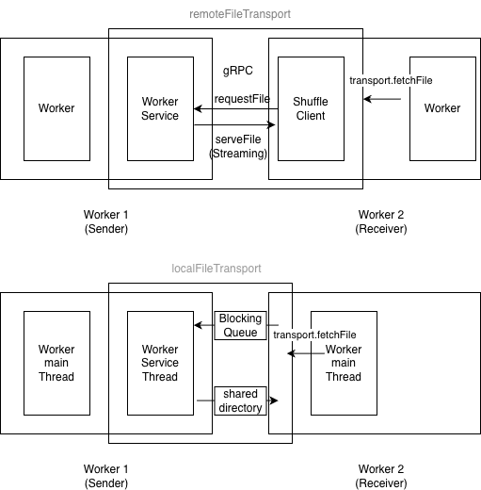
FileTransport Abstraction
- Encapsulate file transfer mechanism
trait FileTransport
LocalFileTransport RemoteFileTransport
(Thread-based) (gRPC-based)
Purpose:
- Local: Test correctness without network
- Remote: Test network communication
- Easy transition between environments

Slide 9
Merge
O
K-way merge
Objective: To efficiently merge k sorted files simultaneously
Data structure: Priority Queue(Min-Heap)
Constraint: The maximum value of k is limited by the available memory
Multi-pass merge
Trigger: the total number of files to be merged exceeds the maximum k
Process: Each pass reads files and merges them, and save the result
I/O optimization: Buffers & Iterators
Streaming with Iterators: avoid loading the entire dataset into memory
Buffering I/O: minimizing the number of expensive disk I/O calls
T1
T2
I1
I2
I3
I4
I5
I6
I7
I8

Slide 10
File I/O
RecordIterator
- Creates an iterator over file content
RecordWriter
- Writes an iterator of records to a file
Iterator
Processes data as a stream to avoid loading all records into memory
Buffering I/O
- Optimizes disk I/O by reducing the number of direct read/write operations
RecordIterator
File
Read
BufferedStream
Parsing
Iterator
consuming
Record
Write
Serialize
RecordWriter

Slide 11
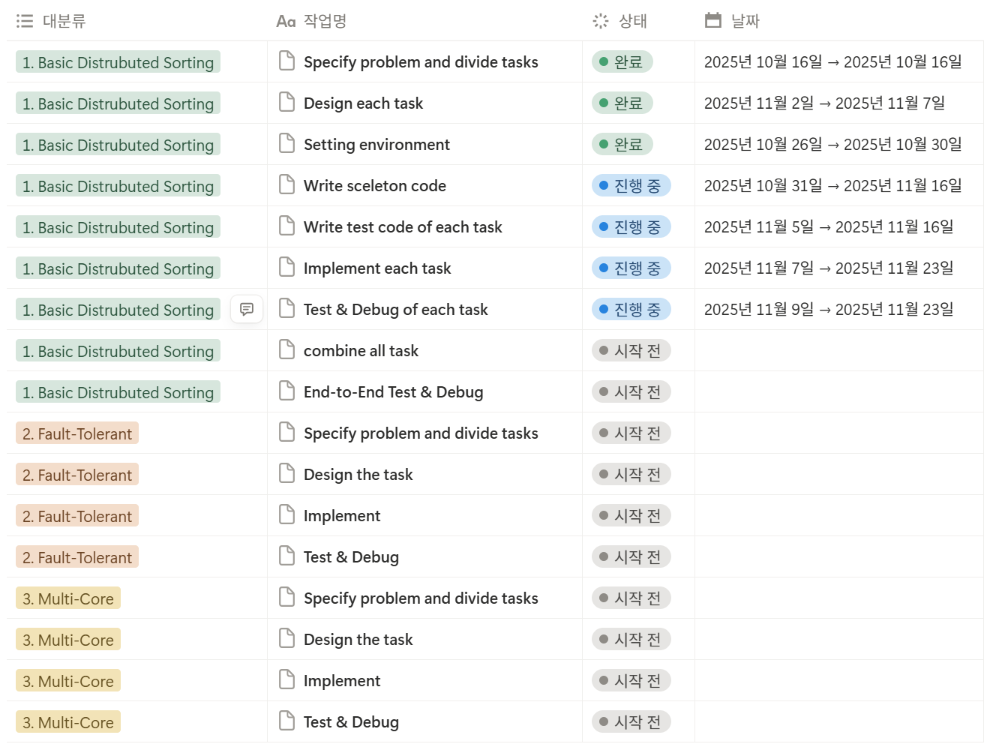
Milestone

